Slide 1
Whip Your Scripts into Shape: Optimizing PowerShell for Speed
Joshua King

Slide 2
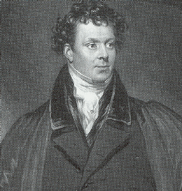
Who Am I?
Josh King
https://king.geek.nz
@WindosNZ

Slide 3





Credit: Tim Whittaker

Slide 4
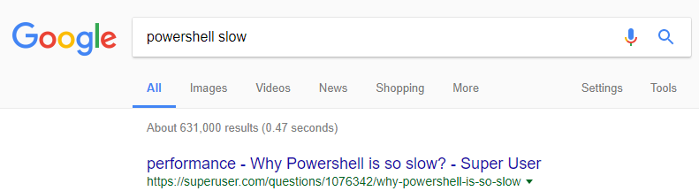
Speed & PowerShell
(Still a better love story than Twilight)
Bad perception, possibly thanks to start up times
Common complaint

Slide 5
A/B Testing
If you’re looking for improvements, measure it!
One change at a time
Test it more than once
Minimize the impact on results introduced by taking measurements

Slide 7
Takeaways
Don’t assume
Measure twice
Revisit
Worry about optimisation after it’s working!
Try out PowerShell Universal Dashboard (https://poshud.com)

Slide 8
Get this slide deck and demo code from:
http://bit.ly/WindosPSH2018

